Slide 1


Mabaret El Asafra Marketing Plan
By:
1- Rahma Mohamed Elsayed
2- Sarah Sameh Elzahaby
3- Sarah Ashraf Gaber
4- Radwa Maged Mohamed
5- Salma Waleed Rady
6- Mariam Ramadan
Under supervision of Dr. Ola Elgeuoshy
2022

Slide 2

Objectives:
Conduct marketing analysis for Mabaret El Asafra labs
Review the current market strategy, marketing programs and marketing analytics.
Develop effective marketing strategy, marketing programs (4 P’s) and marketing analytics for Mabaret El Asafra labs.

Slide 3

Mabaret El Asafra profile:
Mabaret El Asafra Laboratories was established in 1982.
Now, Lab has 10 branches in Alexandria and 13 in Egypt.
2 main branches open 24/7.
It is considered as a mega lab.
They offer around 1200 test in all branches.
Provide affordable prices and upgraded machines.

Slide 4
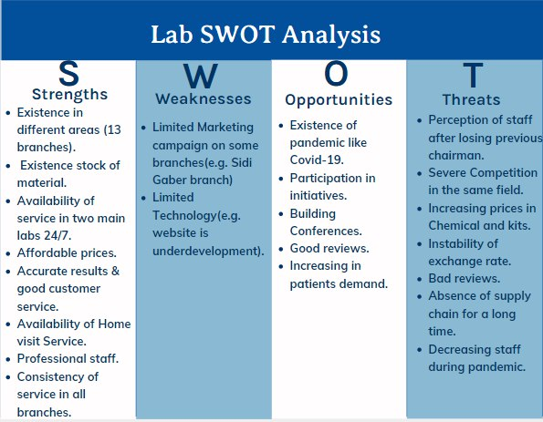

Slide 5
Consumer Behavioral Analysis:
Factors that influence Consumer:
- Family, friends top ref. groups.
- Doctors.
- Social media & bloggers..
Social
Personal
Psychological
- Women preferences, Marriage tests.
- Africans, Europeans
- High, low levels.
- Pregnant women, infants.
-Petrochemical, radiation employees.
- Athletes, fast/junk food eaters.
Conceptual Learning:
Collect information.
Experiential learning:
Patient visit cycle.
Cultural
Buying process:
- A patient recognizes the need to do a specific test.
- Start searching for a laboratory with best properties (accuracy, hygiene, location, reputation, physician’s recommendation).
- Evaluate each choice according to availability of the previous properties.
- Patient obtains the required service in the lab he chosen.
- The individual gives feedback towards the provided service on social media platforms spreading a good word of mouth.
Decision type: Variety Seeking

Slide 6
Buyer Behavioral Analysis:
Factors that influence Buyer:
Economic
Environmental
Organizational
:
ـ Search for suitable tests match their needs as Petroleum companies,Schools
- Search for Good prices suitable their badged
- Must follow governmental policies & WHO.
- Need of suitable high technologies(petrol companies, factories vs schools )
- Trading policies they follow.(Insurance, industrial)
- Safety Standards of stuff, employees, children(School, syndicates)
Buying process:
- Problem recognition: syndicates, Insurance companies want to make tests for employees.
- Need description: make an annual subscription contract to make periodic tests.
- Supplier search: they search for different mega labs.
- Proposal solicitation: they search for different deals in different places.
- Supplier selection: they find the right laboratory with suitable packages.
- Order-routine specification: they take the package periodically with the best offers.
- Performance view: increasing the subscribers to get the privileges related to the selected lab.
Decision type: New task/buy

Slide 7


Customer Driven Marketing Strategy:
Segmentation
Targeting
Geographic : Lower Egypt region
Alexandria districts : Montazah, Sharq , Wassat
Psychographic: A- to B
Demographic: gender , age, marital, occupation
Note : ( They deal with all publics without demographic segmentation , only target each category with different offers )
Business-to-Business (Org. deals) :
Lab-Lab, Syndicates
Strategy: Differentiated
Geographic : through categorizing audience according to regions and districts
Alexandria districts : Montazah, Sharq (eastern Alexandria), Al-Gomrok, Wassat(central Alexandria), El-Dekhila-Agami (western Alexandria) and Al-Amriyah
Regions : Lower Egypt ,Middle Egypt , Upper Egypt , Western Dessert , Sinai
Psychographic : Audience classification by Social class : A-B-C
Positioning
Price/Quality Positioning.
Attribute/Benefit Positioning

Slide 8

Marketing Implementation :
Services:
Provide more than 1,000 test .
Offer accurate results as quick as possible .
Core & augmented service:
Brand name: Mabaret El- Asafra Labs
Design: Logo contains 3 colors to stuck with patients’ mind : Red(Focus, positive), Blue(creativity) and White (Pureness , clarity).
Slogan : مقياس الدقة – #ويستمر_التطوير
Packaging: An envelope contains name, hotline and logo printed on it.
Delivery and Credit.
After sale service.
Empowered and licensed by ISO qualification
Brand’s strategy:
Follow Line Extension

Slide 9

Promotion mix:
AIDA Model
Advertising
Interests:
they tell patients a short brief about that new test, and they are the first lab in Alexandria to prepare for this test, so they create the interest and catch customers’ attention.
Posting advertisements on Facebook page to announce the available offers and hang banners outdoors.
Attention:
they post ads on their Facebook page about hydrogen breath test.
Make special events, participate in conferences, make audiovisual materials
Public Relation
Forming campaigns to send messages on mobile phones to targeted patients to announce for new offers
Direct marketing
Desire:
customers become more seeking to know more details about this test and begin to write comments and to ask about more information.
Action:
customer start share their post to communicate with lab for test.
For B to C making offers, discounts and new packages to encourage patients to come
For B to B follow Advertising specialties
Sales promotion

Slide 10
Strategy:
Working with Rational appeal to meet patient’s needs Furthermore , Follow the pull strategy as one ad targets many users for instance : Facebook posts , conference events and promotions
Budget Basis:
Objectives
Sales Percentage
Set of targets to accomplish then , Determine the cost of the campaign.
Determine the profit and settle certain percentage of revenue for marketing campaigns

Slide 11
Digital marketing status:
1. Search Engine Optimization:
Using this service for making their Facebook page reachable for patients and their Name become at the top of search results.
2. Content Marketing:
Content of Facebook page or website is very important, so they sometimes post health instructions and awareness articles for health or some diseases, sharing any event or conferences they participate in also some short videos for awareness.
Recommendations:
Using email campaigns tool for sending emails to targeted segments when new offers are available that match their needs.
Use affiliate marketing tool to stand out the lab's name and make it more apparent.

Slide 12
Marketing Analytics : KPIs
- The number of new contracts signed for each period.
- The number of qualified employees involved in sales.
- The number of clients retained and their increase.
- Order completion time by the average waiting time of customers.
- Number of visits or number of physician calls.
- Number of visitors to the site.
- Facebook interaction per likes , comments and share.
Recommendations:
- Develop data visualization tools.
- Search about clients’ dissatisfaction reasons.
- Increase the social media ads and make a digital marketing campaign.

Slide 13
Recommendations
Focusing on new branches in other cities to build reputation and strong relationships with new customers.
Focusing more on content marketing by providing more awareness videos from expert doctors about health and seasonal infectious diseases.
Improving their Website’s interface and make it more interactive with provision of online reservations and payments.
Make Kiosks campaigns.

